Slide 1

Synthesizing helper terms in Coq – (Summer ideas)
By Brando Miranda

Slide 2
Ideal Task: Synthesize helper terms that helps complete a proof
Problem: sometimes when doing proofs – one requires an additional Lemma to solve the proof
Good typical example: Generalization of Induction Hypothesis (can provide concrete example later)
<Ideal>: Thus ideally, we want to have a synthesis system that would synthesize useful Coq term that would help close the proof of a theorem
(Currently, this is what I call a lemma, but it we can chat more about what means later
Thus, the task I propose that approximates <Ideal> is:
<Task>: Given a set of theorems with proofs with holes/partial proofs, predict the term that goes in the hole (Coq Term) to complete the proof
So <Task> satisfies some properties of <Ideal>
A. The prediction of the coq term is known to close some proof because that is how it was extracted by the task definition
Remark: one could imagine calling this synthesis system during proof search for some prover in Coq
E.g. Tactician, MathZero, CoqGym’s prover etc.
Next: How to formalize the task?
Notes:
I am using the word synthesis system to be more general than model. I am thinking of this rough approximation:
Synthesis system = (NN) Model + Search
e.g. typical examples
1. NN recognition model + Enumeration
2. Transformer/foundation Model (Generator) + Beam Search
Useful Coq term = term that was actually used to complete the proof of some theorem

Slide 3
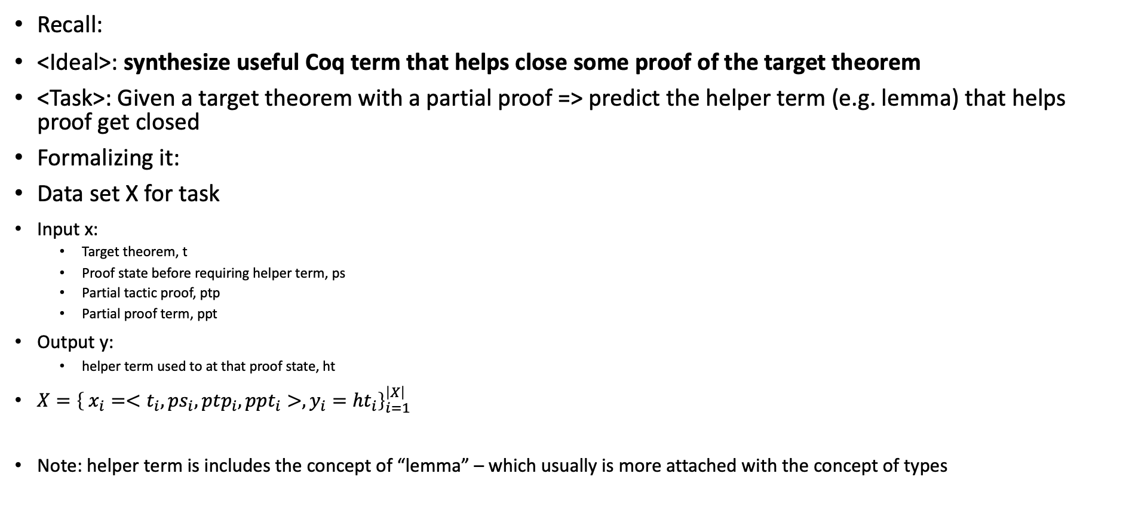
Formalizing Task
Recall:
<Ideal>: synthesize useful Coq term that helps close some proof of the target theorem
<Task>: Given a target theorem with a partial proof => predict the helper term (e.g. lemma) that helps proof get closed
Formalizing it:
Data set X for task
Input x:
Target theorem, t
Proof state before requiring helper term, ps
Partial tactic proof, ptp
Partial proof term, ppt
Output y:
helper term used to at that proof state, ht
$X={\left\{ x_{i}=<t_{i}, ps_{i}, ptp_{i}, ppt_{i}>, y_{i}={ht}_{i}\right\}}_{i=1}^{\left|X\right|}$
Note: helper term is includes the concept of “lemma” – which usually is more attached with the concept of types

Slide 4
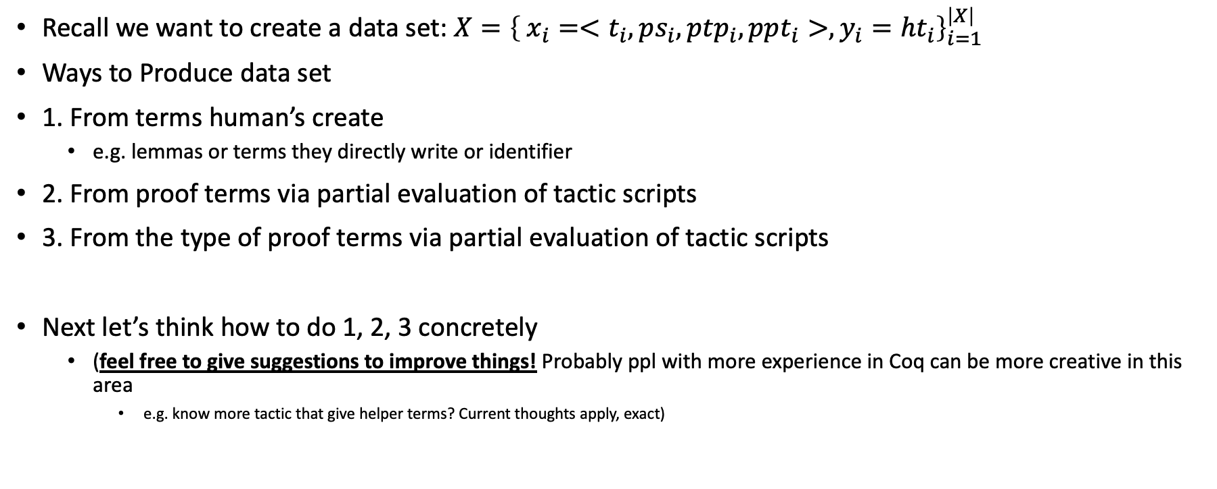
Extracting data set
Recall we want to create a data set: $X={\left\{ x_{i}=<t_{i}, ps_{i}, ptp_{i}, ppt_{i}>, y_{i}={ht}_{i}\right\}}_{i=1}^{\left|X\right|}$
Ways to Produce data set
1. From terms human’s create
e.g. lemmas or terms they directly write or identifier
2. From proof terms via partial evaluation of tactic scripts
3. From the type of proof terms via partial evaluation of tactic scripts
Next let’s think how to do 1, 2, 3 concretely
(feel free to give suggestions to improve things! Probably ppl with more experience in Coq can be more creative in this area
e.g. know more tactic that give helper terms? Current thoughts apply, exact)

Slide 5
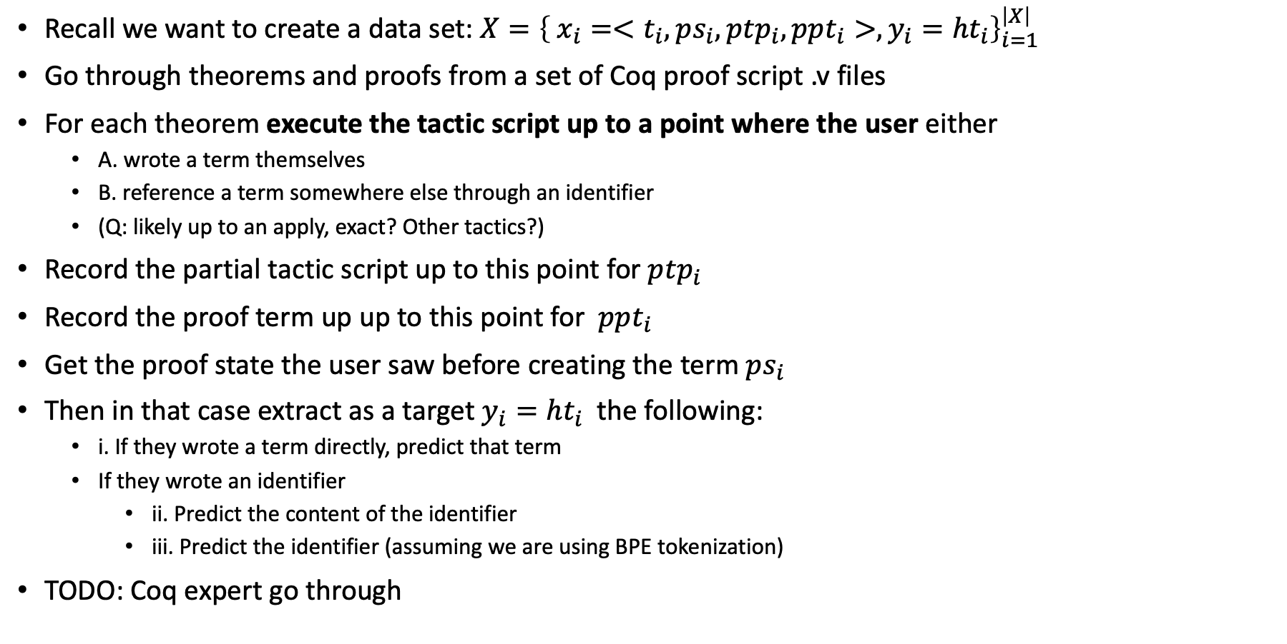
Extracting data set 1: From human’s
Recall we want to create a data set: $X={\left\{ x_{i}=<t_{i}, ps_{i}, ptp_{i}, ppt_{i}>, y_{i}={ht}_{i}\right\}}_{i=1}^{\left|X\right|}$
Go through theorems and proofs from a set of Coq proof script .v files
For each theorem execute the tactic script up to a point where the user either
A. wrote a term themselves
B. reference a term somewhere else through an identifier
(Q: likely up to an apply, exact? Other tactics?)
Record the partial tactic script up to this point for $ptp_{i}$
Record the proof term up up to this point for $ppt_{i}$
Get the proof state the user saw before creating the term $ps_{i}$
Then in that case extract as a target $y_{i}={ht}_{i}$ the following:
i. If they wrote a term directly, predict that term
If they wrote an identifier
ii. Predict the content of the identifier
iii. Predict the identifier (assuming we are using BPE tokenization)
TODO: Coq expert go through

Slide 6
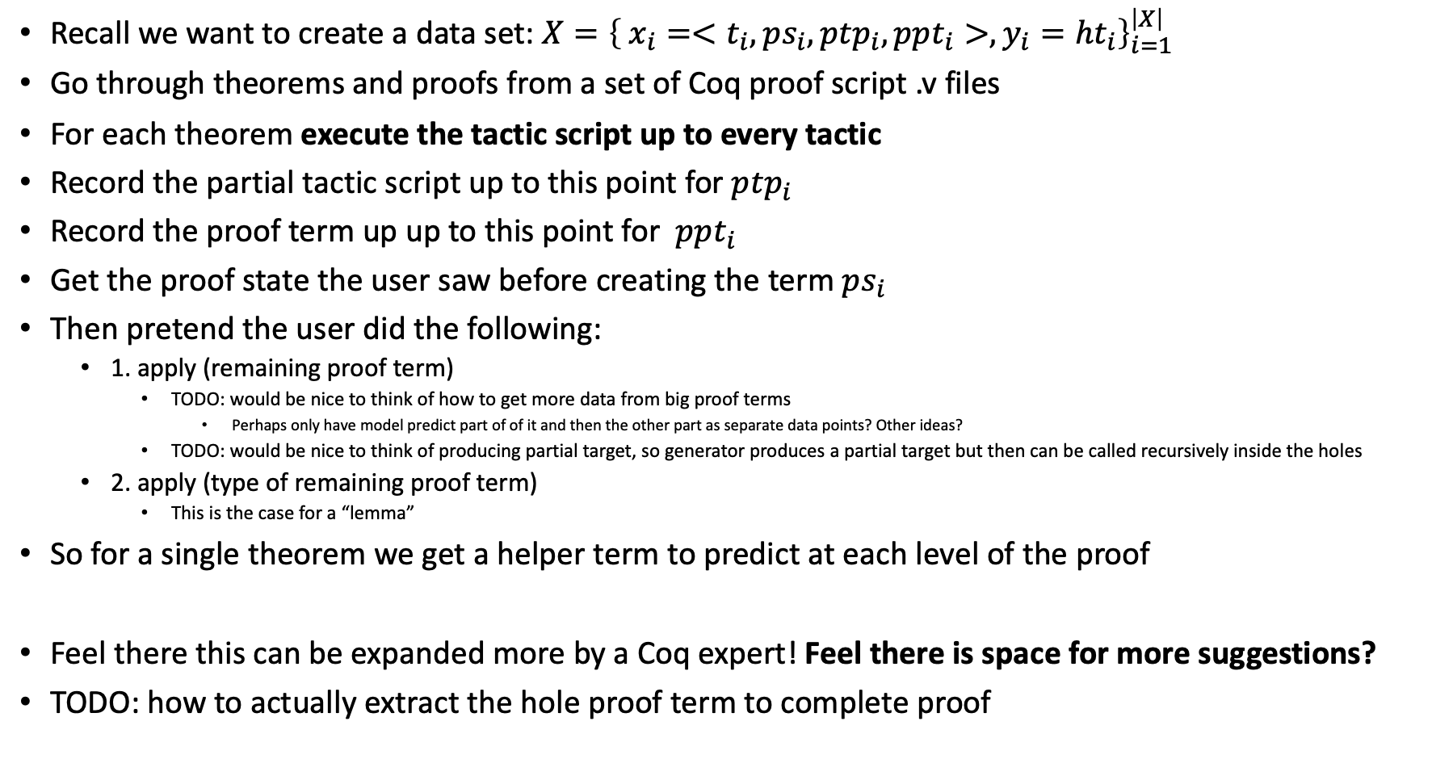
Extracting data set 2: use partial evaluation of proof scripts
Recall we want to create a data set: $X={\left\{ x_{i}=<t_{i}, ps_{i}, ptp_{i}, ppt_{i}>, y_{i}={ht}_{i}\right\}}_{i=1}^{\left|X\right|}$
Go through theorems and proofs from a set of Coq proof script .v files
For each theorem execute the tactic script up to every tactic
Record the partial tactic script up to this point for $ptp_{i}$
Record the proof term up up to this point for $ppt_{i}$
Get the proof state the user saw before creating the term $ps_{i}$
Then pretend the user did the following:
1. apply (remaining proof term)
TODO: would be nice to think of how to get more data from big proof terms
Perhaps only have model predict part of of it and then the other part as separate data points? Other ideas?
TODO: would be nice to think of producing partial target, so generator produces a partial target but then can be called recursively inside the holes
2. apply (type of remaining proof term)
This is the case for a “lemma”
So for a single theorem we get a helper term to predict at each level of the proof
Feel there this can be expanded more by a Coq expert! Feel there is space for more suggestions?
TODO: how to actually extract the hole proof term to complete proof
Notes:
Curious if small holes could be searched through by small brute for synthesizer

Slide 7
Pause: Moment for feedback
Feed back? :)
TODO: come up with some examples, concrete examples!
Of data
Regex example

Slide 8
Quantitative Evaluations
Straight accuracy (Jason): counting when the predicted helper term matches the ground
+ 1
Ideal Goal: if the synthesizer produces helper terms that are true (provable) and helps proof move forward productively (with prover)
Thus, Main metrics:
a. does the synthesizer generate (true) helper terms that move the proof forward (whether it closes proof or not)
gets a +1 if the proof gets unstuck
b. (better one!) does the synthesizer generate (true) helper term(s) in proofs that do get completed?
gets a +1 only if proof gets closed
Two possible environments
0. accuracy of helper term with ground truth
1. Data set with partial proofs (created by us as described) with no Prover, using accuracy only i.e. 0
Extra/Optional:
2. Data set with partial proofs (created by us as described) with Prover
3. Data set training from scratch with Prover + our Synthesizer
Prover: Proof Search, MathZero, our own Proof Search
Notes:
TODO: check skip trees, I think they have good ideas there
Current suggestion: whenever apply or backtrack

Slide 9
Qualitative Evaluations: measuring emergent behaviour
I think this is where one of Talia's suggestions is good.
In transformer models the emergence of novel behaviour is common. Thus, we can measure some that we'd hope/expect/be curious to see:
does it learn human heuristics to create helper terms?
Can our model learn heuristics for generating terms that humans do?
So we'd need to generate:
a. a list of such heuristics
b. a small (5-10) testing representative data set of examples of proofs that usually need such heuristics
Canonical Example: generalizing the induction hypothesis
IH: P 0
HT: forall v, P n (<-)
https://jamesrwilcox.com/InductionExercises.html
other heuristics? (TODO)
Measure: we can measure how many proofs of these heuristic list it closes + we can inspect the helper terms predicted
If it closes many such proofs and it matches the helper terms we expect then we can say it learned those heuristics! (?)
Notes:
https://jamesrwilcox.com/InductionExercises.html

Slide 10
Qualitative Evaluations: measuring emergent behaviour
TODO put example of GH
https://jamesrwilcox.com/InductionExercises.html
Notes:
Ref: https://jamesrwilcox.com/InductionExercises.html

Slide 11
Important slide: Innovation/Story
What do you predict will be the innovation?
Innovation in the current synthesis of helper terms:
Problem: it is technically difficult to train & implement a prover (hardcoding argument). Cast the problem as a direct synthesis term end-to-end with a homogenous model like a large transformer. How much can we do in that route?
Contribution: novel comparison of proving as program synthesis. Novel comparison of proof search vs Synthesize as a method for proving vs combined. In depth study of emergent properties of models.
In compress paper Innovation/story is:
Problem: hardcoded compression/abstraction (DC). Implemented in toy languages.
Contributions: end-to-end learnable compression/abstraction – that hopefully has interesting emergent (not explicitly trained) behaviour from the foundation model.
Notes:
Looking at the output more carefully

Slide 12
What resources will we need?
In terms of compute?
TODO: depends on data size
we are at IBM perhaps it's good to take advantage of that and use a large data set like PACT used.
In terms of data?
TODO: what is the size of the data we have? Who will help me get it if anyone?
In terms of being able to interface with Coq?
Strings is enough. So PyCoq is enough.
(optional: Sending proves for now is optional – especially involvement with a prover)
(optional: a. Does it move proof forward? b. does it complete proof? )
They are optional because checking if the proof hole matches the term intended is easy at least syntactical. (If we want to check for proof completeness we can later)
In terms of tokenizers for Coq?
tokenizer: current is BPE like PACT (need to compare more carefully with skip tree & finish lit review for this)

Slide 13
Handcrafted DSL
TODO

Slide 14
Handling large Context Size
TODO
Mask input for additional noise/robustness + decreases size of input
Output is harder to shrink, ultimately I’m guessing it might depend on the size of the handcrafted DSL?
Why I think compression is important
Feedback:
Other thoughts?

Slide 15
Querying a large data base of facts
TODO
Main thoughts
Classification layer as normal
More advanced:
Pointer net
Memorizing transformers (or related work, e.g. differentiable index thing…)

Slide 16
Data size & Compute size
TODO
My guess is that based on PACT, our data set can be really large ☺
They used 64 A100s…what can we get at IBM comparable in size?

Slide 17
Q: do we really want to give partial tactic script as input?
Q: do we really want to give partial tactic script as input?
What about a hole filler with only proof terms?

Slide 18
What about a hole filler with only proof terms?
Why do I think this one is better?
What about a hole filler with only proof terms?
advantage, disadvantages? relation to compress? why am I thinking about this?

Slide 19
Task proposal/ideas
TODO: put thoughts of
Human types/thms
Type from type of proof term missing
Actual proof (sub)term predicting
Input to the Decoder (token for Gen, Ty, Term, Human, and tactic)
Other more ideas?

Slide 20
Compression 2: learning to predict end to end how to generate abstractions

Slide 22
Appendix

Slide 23
BPE (Byte Pair Encoding) review – A data driver tokenizer for open vocabularies and rare words
Motivation:
BPE solves the problem of how to deal with an open vocabulary (not a fixed vocabulary) and thus rare words.
High-level solution
In particular, it focuses on learning sub-words for the tokenizer in a data-driven way for all words
Hopefully the subwords learned generalizes to future unseen/rare words
Thus, this usually helps in better embeddings, generation of rare words since instead of using the new rare word as a whole you have a way to manipulate them using subwords from the train data set/corpus
Compositionality!
Some vocabulary for the overview:
Segmenter = creates a sequence of tokens in a raw sentence given a vocabulary. Type is Segmenter(C, V) -> list of words/tokens to use.
Learner = induces a token from data corupus
Tokenizer = Segmenter + Vocabulary
Given a new sentence produces a sequence of tokens
Token = symbolic object we have decided has atomic meaning somehow e.g. BPE
Notes:
TODO: what are open vocabulary words an issue in NMT? It’s clear in code but why in MT?
TODO: Q1, more precisely, what is "back-off" dictionaries "machine learning” (method before BPE)

Slide 24
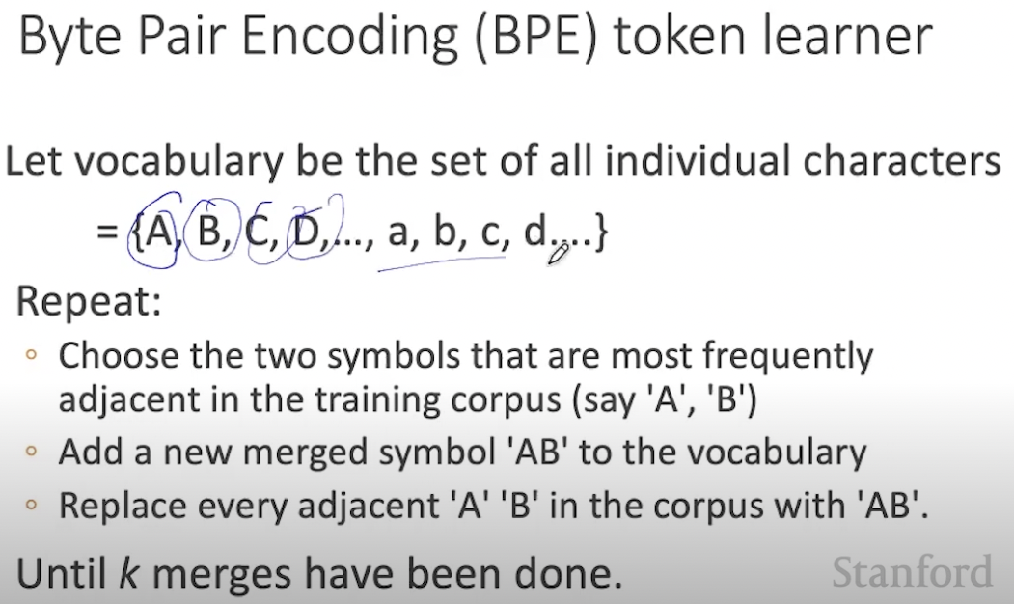
BPE (Byte Pair Encoding) – outline 2
Goal: generate tokens from subwords in the Corpus C (e.g. train dataset) to deal with open Vocabulary problem/rare words.
Algorithm high-level: go through the Corpus (train dataset) by extracting the most common subwords. This is done by analyzing which are the most common pair of subwords up to now and then creating a new subwords from these until we’ve done k merges.
Algorithm:
Notes:
Reference/credit: https://www.youtube.com/watch?v=tOMjTCO0htA&list=PLaZQkZp6WhWy4_bClrW9EGQKnUUD9yp8V&index=5&t=65s

Slide 25
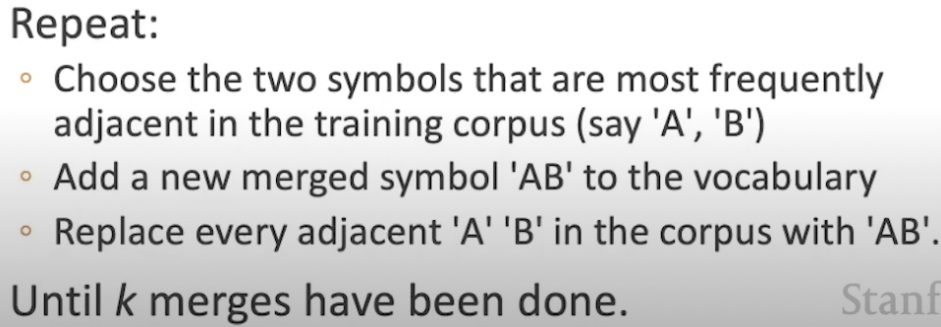
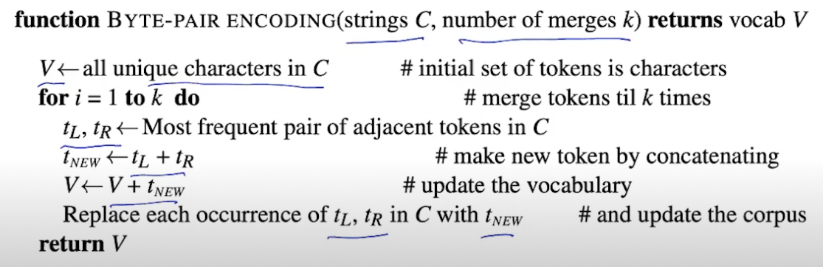
BPE (Byte Pair Encoding) – outline 2
Goal: generate tokens from subwords in the Corpus C (e.g. train dataset) to deal with open Vocabulary problem/rare words.
1. High-level:
2. Slightly more detailed:
Notes:
Reference/credit: https://www.youtube.com/watch?v=tOMjTCO0htA&list=PLaZQkZp6WhWy4_bClrW9EGQKnUUD9yp8V&index=5&t=65s

Slide 26
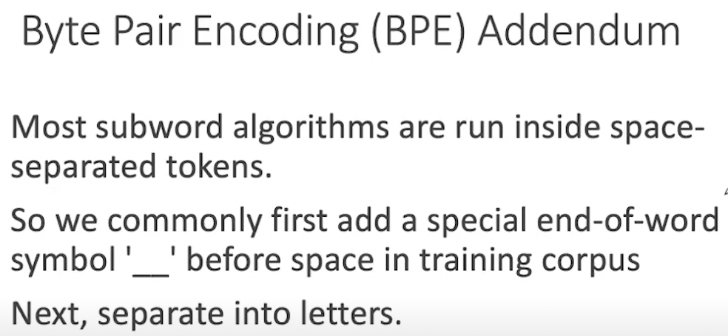
BPE - Comment on white spaces for NL
Comment

Slide 27
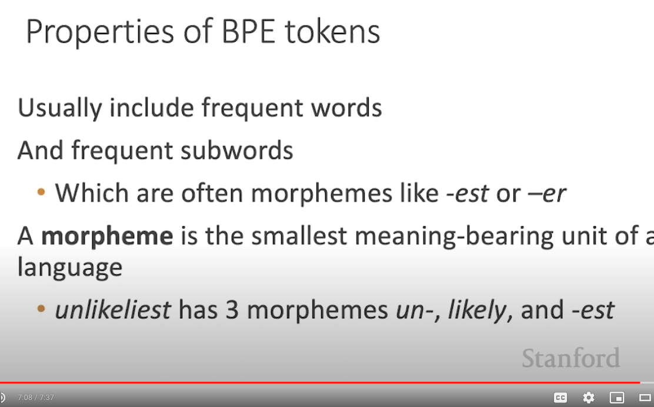
BPE – Comment on common properties
Comment
Notes:
Morpheme = smallest meaning-bearing unit of language. E.g. incoming -> in, come, ing.
Lexicon = the complete set of meaningful units = approx. the Vocab & grammar = where the vocab is usually (in NL) the morphemes and the ”real words”. V = (M, RW)
Lexeme = an element in the lexicon.Vocab. So a real word or a morpheme (approximately). TODO improve.

Slide 28
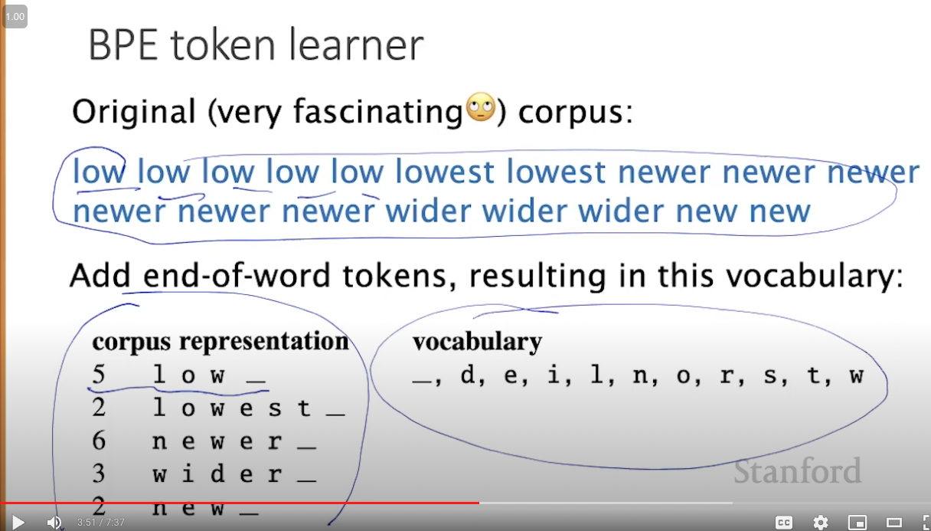
BPE – Example: Consider a text to tokenize
Consider the follow text to tokenize that will be used for the step by step example of the BPE algorithm

Slide 29
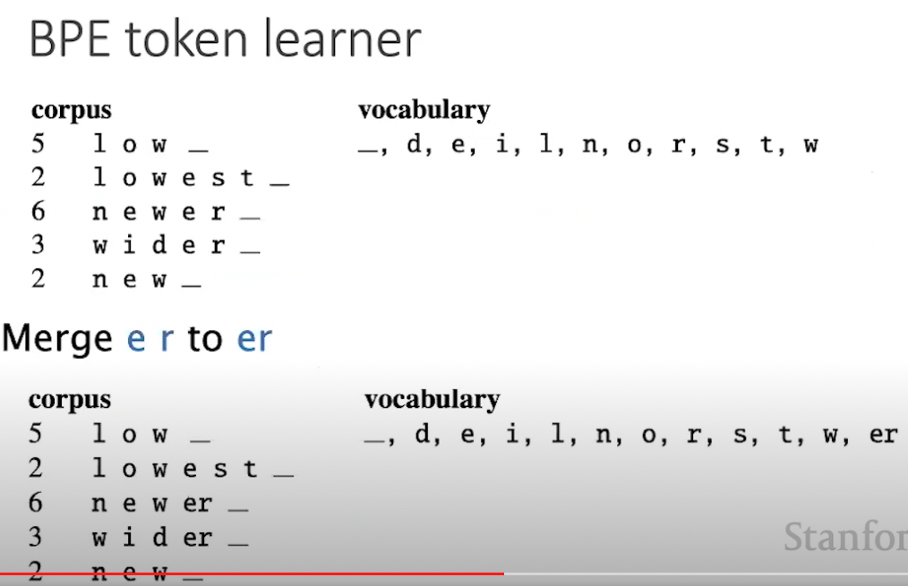
BPE – Example: Step 1, merge the most common characters
Every step is merge the most common tokens in tokens according to our **current Vocab** and **current Corpus** according to that vocab
Since it’s the 1st step it will merge the most common characters – “e”,”r”->”er”

Slide 30
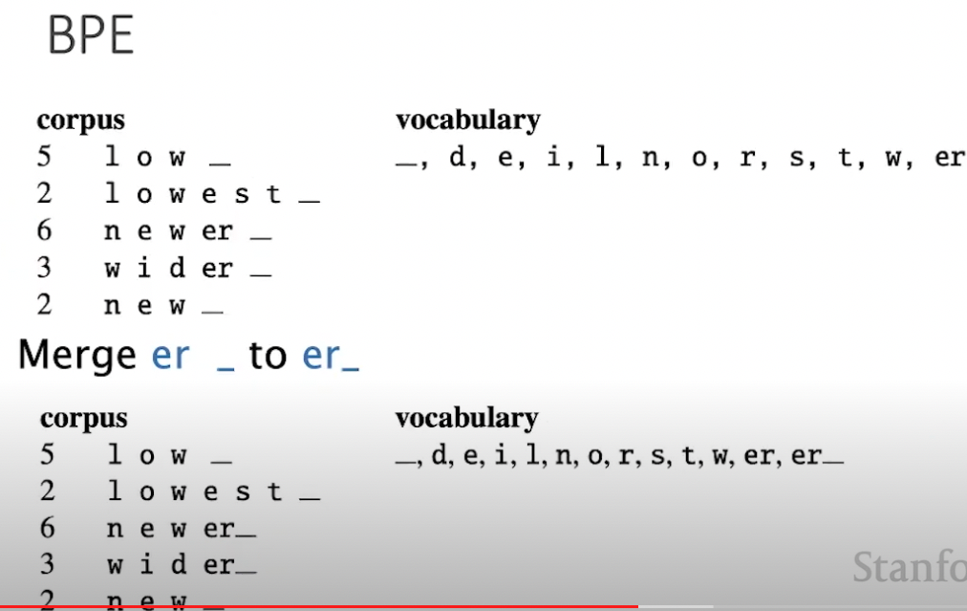
BPE – Example: Step 2, merge the most common token with space
Every step is merge the most common tokens in tokens according to our **current Vocab** and **current Corpus** according to that vocab
Since it’s the 2nd step it will merge the most common tokens “er” and space – “er”, “_” -> ”er_”

Slide 31
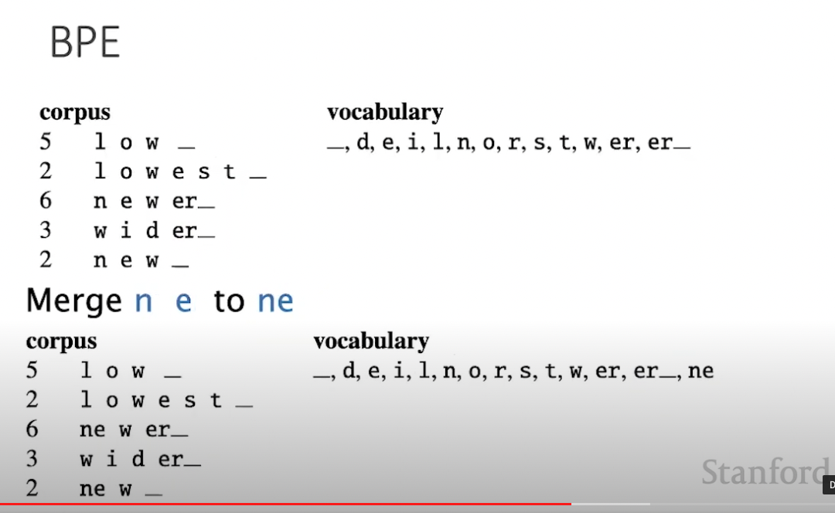
BPE – Example: Step 3, merge the most common tokens
Every step is merge the most common tokens in tokens according to our **current Vocab** and **current Corpus** according to that vocab
Now dpes – “n”,”e”->”ne”

Slide 32
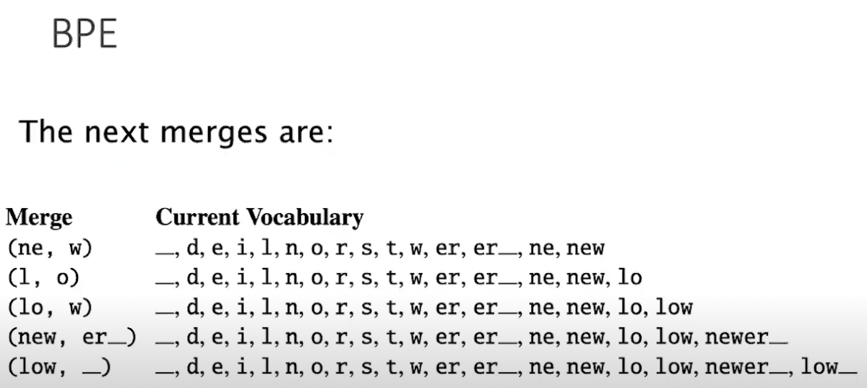
BPE – Example: remaining steps for k=8 merges
Every step is merge the most common tokens in tokens according to our **current Vocab** and **current Corpus** according to that vocab

Slide 33
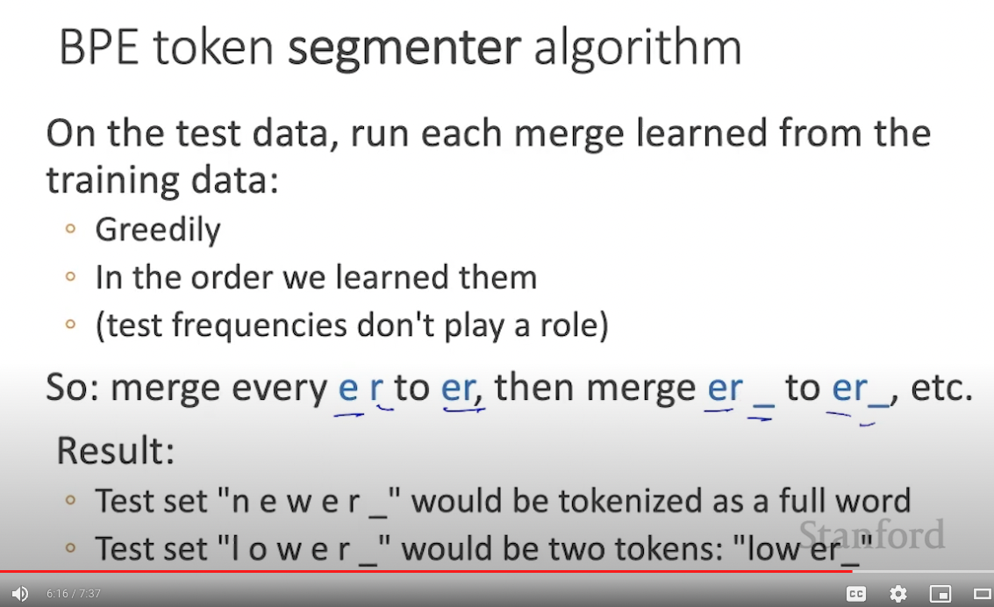
BPE – at test time using our Example
(current) Vocabulary
Notes:
Segmenter(C, V) -> list of words/tokens to use.
Learner, induces a token from data
Segmenter, does tokenization given vocabulary
Tokenizer = Segmenter + Vocabulary

Slide 34
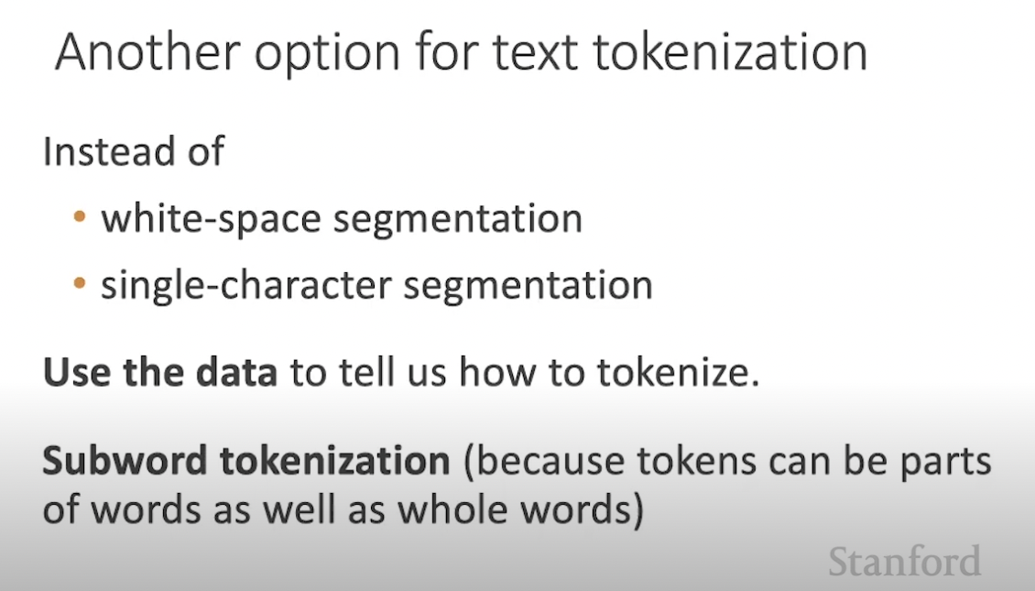
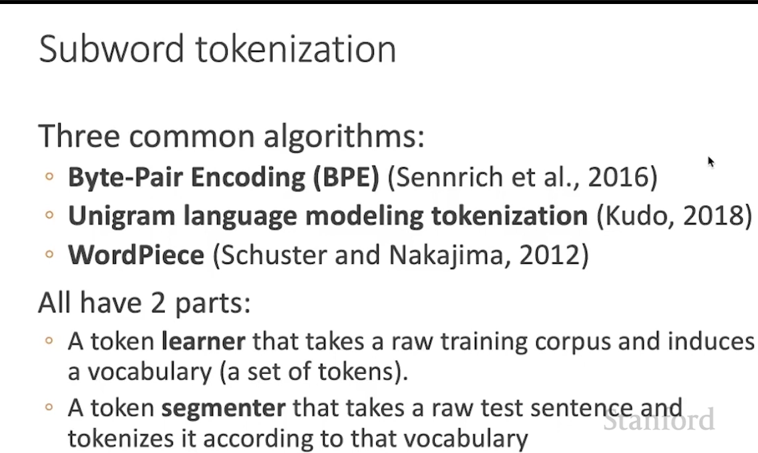
Other options

Slide 35
Reference
Reference: Stanford lecture https://youtu.be/tOMjTCO0htA

Slide 36
Previous work
REFACTOR uses character tokens & GNNs
https://openreview.net/forum?id=827jG3ahxL
PACT: uses standard BPE tokenization ala GPT-3
They cite the GPT-3 paper https://arxiv.org/abs/2005.14165
GPT-f: uses BPE tokenization ala GPT-3
They cite the same paper as PACT, the gpt-3 paper https://arxiv.org/abs/2005.14165
GPT-3
Slightly more precise on what type of tokenization/BPE GPT-3 exactly does
Skip trees:
TODO, I think this one is particularly important
Codex:
TODO
Alpha Code
TODO
TreeGen
TODO, ASTs (not csts)
PaLM
TODO
DreamCoder
TODO, I think also ASTs + abstractions (so IDs)
PolyCode
TODO
GPT-neo
GPT-J
GPT-neoX
LIME
Hugging face code parrot and other stuff
Others to check out before final decision?
Notes:
Hugging face links
https://huggingface.co/lvwerra/codeparrot
https://huggingface.co/blog/codeparrot
https://huggingface.co/spaces/facebook/incoder-demo

